Slide 1


Chapter 10
Getting Funding or Financing
Bruce R. Barringer
R. Duane Ireland
Copyright ©2012 Pearson Education, Inc. publishing as Prentice Hall
10-<number>

Slide 2
Chapter Objectives
1 of 2
Explain why most entrepreneurial ventures need to raise money during their early life.
Identify the three sources of personal financing available to entrepreneurs.
Provide examples of how entrepreneurs bootstrap to raise money or cut costs.
Identify the three steps involved in properly preparing to raise debt or equity financing.
Discuss the difference between equity funding and debt financing.
Copyright ©2012 Pearson Education, Inc. publishing as Prentice Hall
10-<number>

Slide 3
Chapter Objectives
2 of 2
Explain the role of an elevator speech in attracting financing for an entrepreneurial venture.
Describe the difference between a business angel and a venture capitalist.
Explain why an initial public offering (IPO) is an important milestone in an entrepreneurial venture.
Discuss the SBA Guaranteed Loan Program.
Explain the advantages of leasing for an entrepreneurial venture.
Copyright ©2012 Pearson Education, Inc. publishing as Prentice Hall
10-<number>

Slide 4
The Importance of Getting Financing or Funding
The Nature of the Funding and Financing Process
  Few people deal with the process of raising investment capital until they need to raise capital for their own firm.
    As a result, many entrepreneurs go about the task of raising capital haphazardly because they lack experience in this area.
Why Most New Ventures Need Funding
  There are three reasons most new ventures need to raise money during their early life.
    The three reasons are shown on the following slide.
Copyright ©2012 Pearson Education, Inc. publishing as Prentice Hall
10-<number>

Slide 5
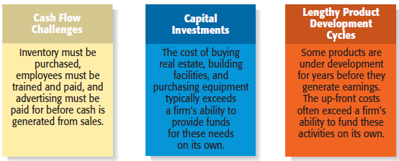
Why Most New Ventures Need Financing or Funding
Copyright ©2012 Pearson Education, Inc. publishing as Prentice Hall
10-<number>

Slide 6
Alternatives for Raising Money for a
New Venture
Personal Funds
Equity Capital
Debt Financing
Creative Sources
Copyright ©2012 Pearson Education, Inc. publishing as Prentice Hall
10-<number>

Slide 7
Sources of Personal Financing
1 of 2
Personal Funds
  The vast majority of founders contribute personal funds, along with sweat equity, to their ventures.
    Sweat equity represents the value of the time and effort that a founder puts into a new venture.
Friends and Family
  Friends and family are the second source of funds for many new ventures.
Copyright ©2012 Pearson Education, Inc. publishing as Prentice Hall
10-<number>

Slide 8
Sources of Personal Financing
2 of 2
Bootstrapping
  A third source of seed money for a new venture is referred to as bootstrapping.
  Bootstrapping is finding ways to avoid the need for external financing or funding through creativity, ingenuity, thriftiness, cost cutting, or any means necessary.
  Many entrepreneurs bootstrap out of necessity.
Copyright ©2012 Pearson Education, Inc. publishing as Prentice Hall
10-<number>

Slide 9
Examples of Bootstrapping Methods
Buying used instead of
new equipment
Coordinating purchases
with other businesses
Leasing equipment
instead of buying
Obtaining payments in
advance from
customers
Minimizing personal
expenses
Avoiding unnecessary
expenses
Buying items cheaply but
prudently via options
such as eBay
Sharing office space or
employees with other
businesses
Hiring interns
Copyright ©2012 Pearson Education, Inc. publishing as Prentice Hall
10-<number>

Slide 10
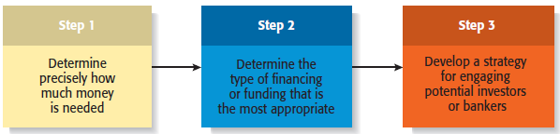
Preparing to Raise Debt or Equity Financing
1 of 3
Copyright ©2012 Pearson Education, Inc. publishing as Prentice Hall
10-<number>

Slide 11
Preparing to Raise Debt or Equity Financing
2 of 3
Two Most Common Alternatives
Equity Funding
Debt Financing
Means exchanging partial ownership in a firm, usually in the form of stock, for funding
Is getting a loan
Copyright ©2012 Pearson Education, Inc. publishing as Prentice Hall
10-<number>

Slide 12
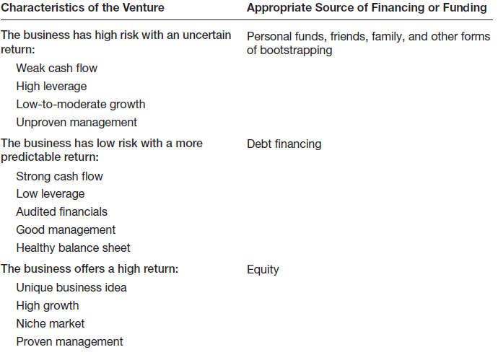
Preparing to Raise Debt or Equity Financing
3 of 3
Matching a New Venture’s Characteristics with the Appropriate Form of Financing or Funding
Copyright ©2012 Pearson Education, Inc. publishing as Prentice Hall
10-<number>

Slide 13
Preparing An Elevator Speech
1 of 2
Purpose
An elevator speech is a brief,
carefully constructed statement
that outlines the merits of a
business opportunity.
There are many occasions when a
carefully constructed elevator
speech might come in handy.
Most elevator speeches are 45
seconds to 2 minutes long.
Elevator Speech
Copyright ©2012 Pearson Education, Inc. publishing as Prentice Hall
10-<number>

Slide 14
Preparing an Elevator Speech
2 of 2
Step 1
Describe the opportunity or problem that needs to be solved.
20 seconds
Describe how your product meets the opportunity or solves the problem.
20 seconds
Step 2
Step 3
Describe your qualifications.
10 seconds
Describe your market.
Step 4
10 seconds
Total
60 seconds
Copyright ©2012 Pearson Education, Inc. publishing as Prentice Hall
10-<number>

Slide 15
Sources of Equity Funding
Venture Capital
Business Angels
Initial Public Offerings
Copyright ©2012 Pearson Education, Inc. publishing as Prentice Hall
10-<number>

Slide 16
Business Angels
1 of 2
Business Angels
  Are individuals who invest their personal capital directly in start-ups.
  The prototypical business angel is about 50 years old, has high income and wealth, is well educated, has succeeded as an entrepreneur, and is interested in the start-up process.
  The number of angel investors in the U.S. has increased dramatically over the past decade.
Copyright ©2012 Pearson Education, Inc. publishing as Prentice Hall
10-<number>

Slide 17
Business Angels
2 of 2
Business Angels (continued)
  Business angels are valuable because of their willingness to make relatively small investments.
    These investors generally invest between $10,000 and $500,000 in a single company.
    Are looking for companies that have the potential to grow between 30% to 40% per year.
  Business angels are difficult to find.
Copyright ©2012 Pearson Education, Inc. publishing as Prentice Hall
10-<number>

Slide 18
Venture Capital
1 of 3
Venture Capital
  Is money that is invested by venture capital firms in start-ups and small businesses with exceptional growth potential.
  There are about 800 venture capital firms in the U.S.
    Venture capital firms are limited partnerships of money managers who raise money in “funds” to invest in start-ups and growing firms.
    The funds, or pool of money, are raised from wealthy individuals, pension plans, university endowments, foreign investors, and similar sources.
    The investors who invest in venture capital funds are called limited partners. The venture capitalists are called general partners.
Copyright ©2012 Pearson Education, Inc. publishing as Prentice Hall
10-<number>

Slide 19
Venture Capital
2 of 3
Venture Capital (continued)
  Venture capital firms fund very few entrepreneurial firms in comparison to business angels.
    Many entrepreneurs get discouraged when they are repeatedly rejected for venture capital funding, even though they may have an excellent business plan.
    Venture capitalists are looking for the “home run” and so reject the majority of the proposals they consider.
    Venture capitalists fund between 3,000 and 4,000 companies per year, compared to about 62,000 per year for business angels.
Copyright ©2012 Pearson Education, Inc. publishing as Prentice Hall
10-<number>

Slide 20
Venture Capital
3 of 3
Venture Capital (continued)
  An important part of obtaining venture capital funding is going through the due diligence process.
  Venture capitalists invest money in start-ups in “stages,” meaning that not all the money that is invested is disbursed at the same time.
  Some venture capitalists also specialize in certain “stages” of funding.
Copyright ©2012 Pearson Education, Inc. publishing as Prentice Hall
10-<number>

Slide 21
Initial Public Offering
1 of 3
Initial Public Offering
  An initial public offering (IPO) is a company’s first sale of stock to the public. When a company goes public, its stock is traded on one of the major stock exchanges.
  Most entrepreneurial firms that go public trade on the NASDAQ, which is weighted heavily toward technology, biotech, and small-company stocks.
  An IPO is an important milestone for a firm. Typically, a firm is not able to go public until it has demonstrated that it is viable and has a bright future.
Copyright ©2012 Pearson Education, Inc. publishing as Prentice Hall
10-<number>

Slide 22
Initial Public Offering
2 of 3
Reasons that Motivate Firms to Go Public
Reason 1
Reason 2
Is a way to raise equity capital to fund current and future operations.
Raises a firm’s public profile, making it easier to attract high-quality customers and business partners.
Copyright ©2012 Pearson Education, Inc. publishing as Prentice Hall
10-<number>

Slide 23
Initial Public Offering
3 of 3
Reasons that Motivate Firms to Go Public
Reason 3
Reason 4
Is a liquidity event that provides a means for a company’s investors to recoup their investments.
Creates a form of currency that can be used to grow the company via acquisitions.
Copyright ©2012 Pearson Education, Inc. publishing as Prentice Hall
10-<number>

Slide 24
Sources of Debt Financing
Commercial Banks
SBA Guaranteed Loans
Copyright ©2012 Pearson Education, Inc. publishing as Prentice Hall
10-<number>

Slide 25
Commercial Banks
Banks
  Historically, commercial banks have not been viewed as a practical source of financing for start-up firms.
  This sentiment is not a knock against banks; it is just that banks are risk averse, and financing start-ups is a risky business.
    Banks are interested in firms that have a strong cash flow, low leverage, audited financials, good management, and a healthy balance sheet.
Copyright ©2012 Pearson Education, Inc. publishing as Prentice Hall
10-<number>

Slide 26
SBA Guaranteed Loans
1 of 2
The SBA Guaranteed Loan Program
  Approximately 50% of the 9,000 banks in the U.S. participate in the SBA Guaranteed Loan Program.
  The program operates through private-sector lenders who provide loans that are guaranteed by the SBA.
  The loans are for small businesses that are not able to obtain credit elsewhere.
The 7(A) Loan Guarantee Program
  The most notable SBA program available to small businesses.
Copyright ©2012 Pearson Education, Inc. publishing as Prentice Hall
10-<number>

Slide 27
SBA Guaranteed Loans
2 of 2
Size and Types of Loans
  Almost all small businesses are eligible to apply for an SBA guaranteed loan.
  The SBA can guarantee as much as 85% on loans up to $150,000 and 75% on loans over $150,000.
  An SBA guaranteed loan can be used for almost any legitimate business purpose.
  Although SBA guaranteed loans are utilized more heavily by existing small businesses than start-ups, they should not be dismissed as a possible source of financing.
Copyright ©2012 Pearson Education, Inc. publishing as Prentice Hall
10-<number>

Slide 28
Other Sources of Debt Financing
1 of 2
Vendor Credit
  Also known as trade credit, is when a vendor extends credit to a business in order to allow the business to buy its products and/or services up front but defer payment until later.
Factoring
  Is a financial transaction whereby a business sells its accounts receivable to a third party, called a factor, at a discount in exchange for cash.
Copyright ©2012 Pearson Education, Inc. publishing as Prentice Hall
10-<number>

Slide 29
Other Sources of Debt Financing
2 of 2
Peer-to-Peer Lending
  Is a financial transaction that occurs directly between individuals or peers.
  Prosper is the best know peer-to-peer lending network.
Crowdfunding
  A form of raising money that takes place, usually via the Internet, where people pool their money to support a start-up or other initiative, usually in return for some sort of amenity rather than loan.
  Kickstarter is a popular online crowdfunding platform.
Copyright ©2012 Pearson Education, Inc. publishing as Prentice Hall
10-<number>

Slide 30
Creative Sources of Financing or Funding
SBIR and STTR Grant Programs
Leasing
Other Grant Programs
Strategic Partners
Copyright ©2012 Pearson Education, Inc. publishing as Prentice Hall
10-<number>

Slide 31
Leasing
1 of 2
Leasing
  A lease is a written agreement in which the owner of a piece of property allows an individual or business to use the property for a specified period of time in exchange for payments.
  The major advantage of leasing is that it enables a company to acquire the use of assets with very little or no down payment.
Copyright ©2012 Pearson Education, Inc. publishing as Prentice Hall
10-<number>

Slide 32
Leasing
2 of 2
Leasing (continued)
  Most leases involve a modest down payment and monthly payments during the duration of the lease.
  At the end of an equipment lease, the new venture typically has the option to stop using the equipment, purchase it for fair market value, or renew the lease.
  Leasing is almost always more expensive than paying cash for an item, so most entrepreneurs think of leasing as an alternative to equity or debt financing.
Copyright ©2012 Pearson Education, Inc. publishing as Prentice Hall
10-<number>

Slide 33
SBIR and STTR Grants
1 of 4
SBIR and STTR Programs
  The Small Business Innovation Research (SBIR) and the Small Business Technology Transfer (STTR) programs are two important sources of early-stage funding for technology firms.
  These programs provide cash grants to entrepreneurs who are working on projects in specific areas.
    The main difference between the SBIR and the STTR programs is that the STTR program requires the participation of researchers working at universities or other research institutions.
Copyright ©2012 Pearson Education, Inc. publishing as Prentice Hall
10-<number>

Slide 34
SBIR and STTR Grants
2 of 4
SBIR Program
  The SBIR Program is a competitive grant program that provides over $1 billion per year to small businesses in early-stage and development projects.
  Each year, 11 federal departments and agencies are required by the SBIR to reserve a portion of their R&D funds for awards to small businesses.
  Guidelines for how to apply for the grants are provided on each agency’s Web site.
Copyright ©2012 Pearson Education, Inc. publishing as Prentice Hall
10-<number>

Slide 35
SBIR and STTR Grants
3 of 4
SBIR Program (continued)
  The SBIR is a three-phase program, meaning that firms that qualify have the potential to receive more than one grant to fund a particular proposal.
  Historically, less than 15% of all Phase I proposals are funded. The payoff for successful proposals, however, is high.
    The money is essentially free. It is a grant, meaning that it doesn’t have to be paid back and no equity in the firm is at stake.
    The small business receiving the grant also retains the rights to any intellectual property generated as the result of the grant initiative.
Copyright ©2012 Pearson Education, Inc. publishing as Prentice Hall
10-<number>

Slide 36
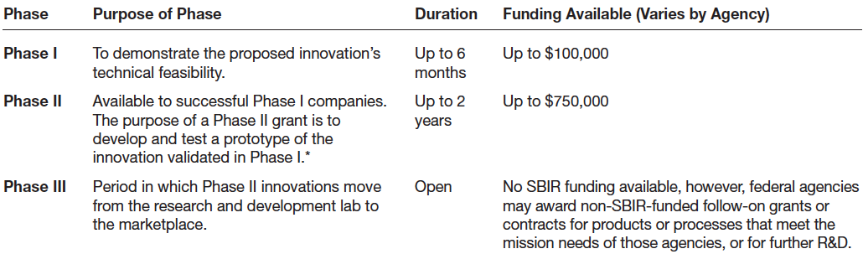
SBIR and STTR Grants
4 of 4
SBIR Three-Phase Grant Program
Copyright ©2012 Pearson Education, Inc. publishing as Prentice Hall
10-<number>

Slide 37
Other Grant Programs
Private Grants
  There are a limited number of grant programs available.
  Getting grants takes a little detective work.
  Granting agencies are low key, and must be sought out.
Other Government Grants
  The federal government has grant programs beyond the SBIR and STTR programs.
  The full spectrum of grants available is listed at www.grants.gov.
  Be careful of grant-related scams.
Copyright ©2012 Pearson Education, Inc. publishing as Prentice Hall
10-<number>

Slide 38
Strategic Partners
1 of 2
Strategic Partners
  Strategic partners are another source of capital for new ventures.
  Many partnerships are formed to share the costs of product or service development, to gain access to particular resources, or to facilitate speed to market.
  Older established firms benefit by partnering with young entrepreneurial firms by gaining access to their creative ideas and entrepreneurial spirit.
Copyright ©2012 Pearson Education, Inc. publishing as Prentice Hall
10-<number>

Slide 39

Strategic Partners
2 of 2
Biotech firms often partner
with large drug companies
to conduct clinical trials and
bring new products to
market.
The biotech firms benefit by
obtaining funding from their
partners, and the partners
benefit by having additional
products to sell.
Copyright ©2012 Pearson Education, Inc. publishing as Prentice Hall
10-<number>

Slide 40

All rights reserved. No part of this publication may be reproduced, stored in a retrieval system, or transmitted, in any form or by any means, electronic, mechanical, photocopying, recording, or otherwise, without the prior written permission of the publisher. Printed in the United States of America.
Copyright ©2012 Pearson Education, Inc. publishing as Prentice Hall
Copyright ©2012 Pearson Education, Inc. publishing as Prentice Hall
10-<number>

